Slide 1
Concorde Group Website

Slide 2
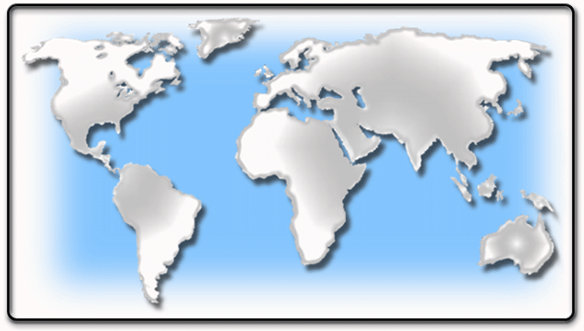
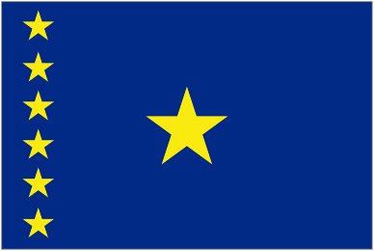
WHO WE ARE
The Group is a multi-faceted set of companies operating in several regions of the world.
The Group is a leader in providing products and services in diversified business sectors in the areas of Mining, industrial, electronics, fashion, general trading, real estate, telecommunication and other investments.
Concorde Group is present in several regions of the world like Africa (DRC, Brazzaville and Ivory Coast), USA, Middle East (UAE, Lebanon, and Egypt), China, Brazil and others.
U.S.A.
CHINA
LEBANON
EGYPT
IVORY COAST
UAE
BRAZIL
DRC

Slide 3
II. OUR MISSION
As a group with a diversified portfolio, Concorde Group mission is to provide exceptional products and services in different fields as well as meeting the needs to the clients and working to ensure successful outcomes.
III. OUR GOALS
Maximize Shareholders value by increasing revenues and controlling expenditures.
Commitment to exceed customer’s expectation by providing high quality and innovative products and services.
Work on geographical expansion, improving business processes and strengthening partners relationship.
Acquire and retain skillful and talented human resources.
Alliance with various international concepts and entities to realize the above.

Slide 4
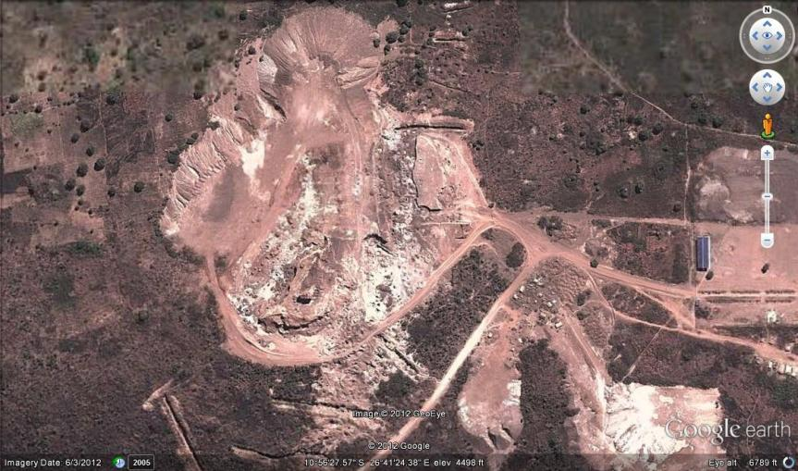
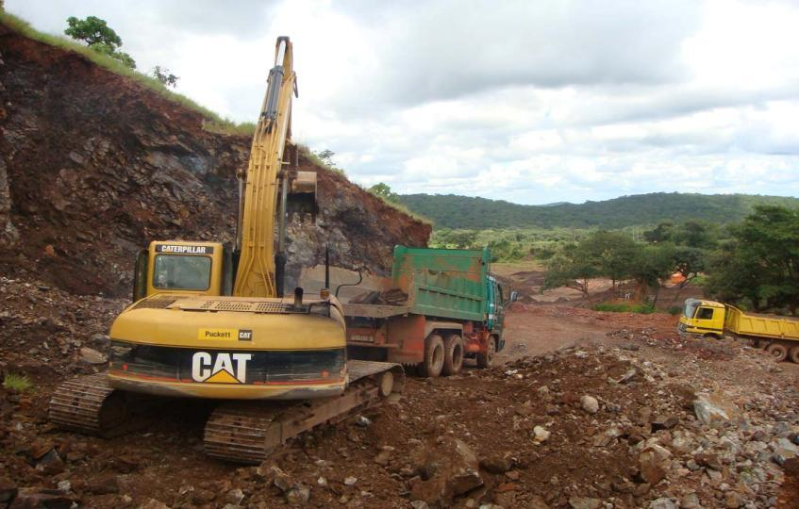
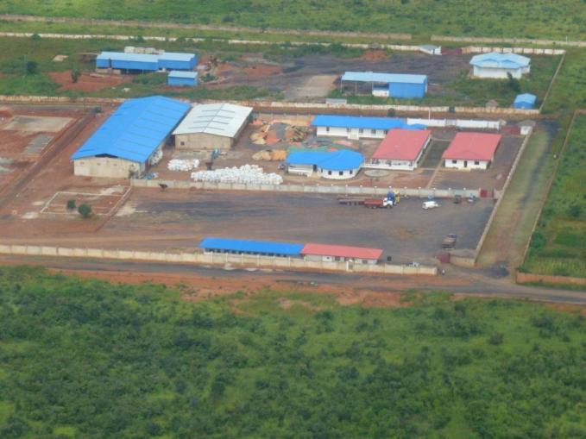
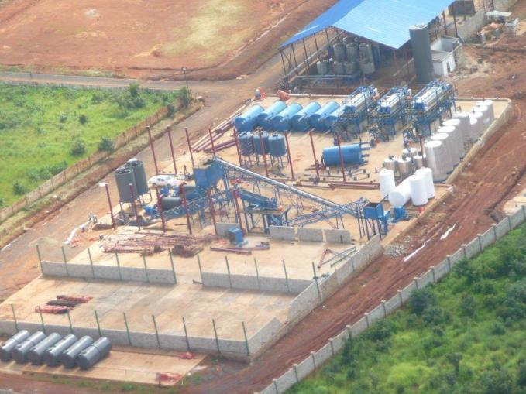
IV. OUR PORTFOLIO
Mining & Processing: Concorde Group is involved in major and massive Mining and processing projects in African Region. In the Democratic Republic of Congo the Group is involved in exploitation, exploration and processing of copper, cobalt, coltan, gold and other metals and minerals. Concorde Group brings years of expertise to the table with an experienced staff and their know-how in mineral and metal production industry.

Slide 5
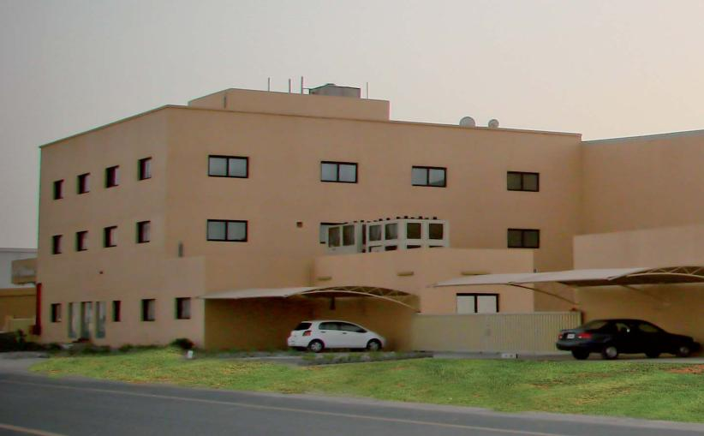
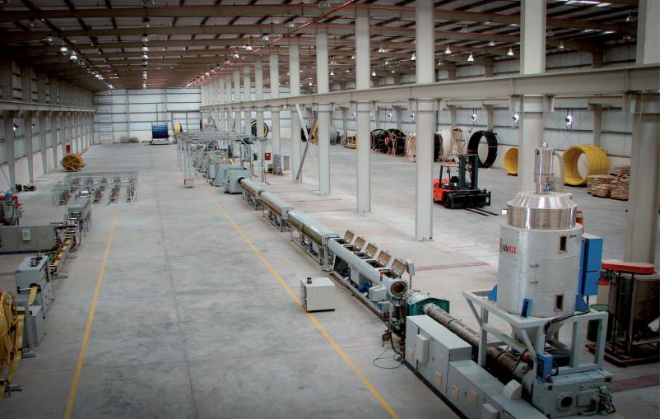
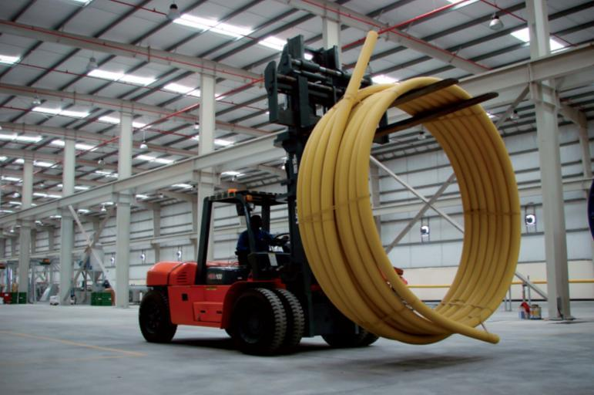
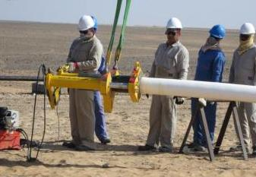
Industrial & Manufacturing: Concorde Group has established in UAE a Factory that produces PVC and RTP-Reinforced Thermoplastic Pipes under license from Advance Tech, a global leader in Engineering, Technologies and Construction services for oil and gas. RTP-Reinforced Thermoplastic Pipes are high pressure flexible pipes mainly for deep water injection, oil production installations and gas transport, and can also be used for filtered /drinkable water pipelines. Reinforced Thermoplastic Pipe (RTP) is a possible substitute to steel pipelines for high pressure applications

Slide 6
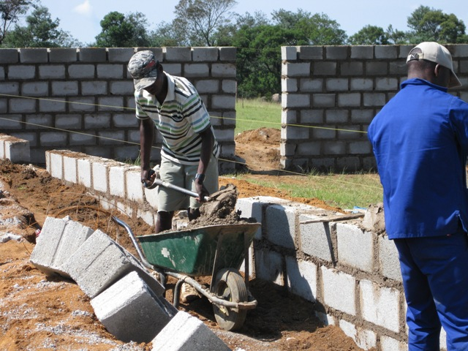
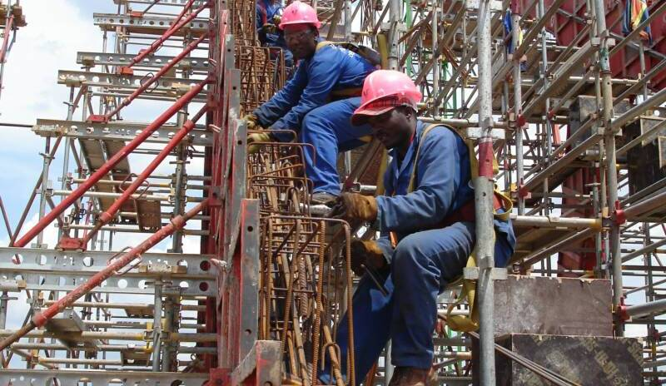
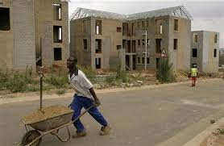
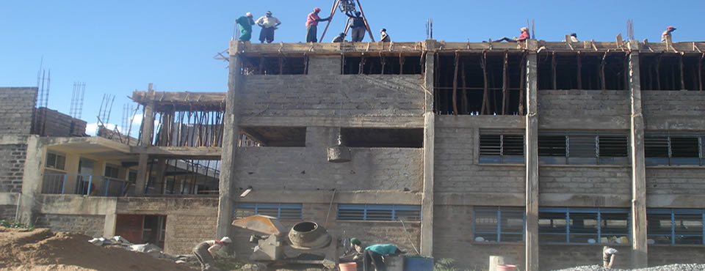
Construction: Concorde Group is a primary contractor and infrastructure developer with colossal experience in building complex projects. Concorde Group operates in the Democratic republic of Congo as a national contractor and infrastructure development company. The group has a reputed record of completing projects on time without compromising on quality and durability. The projects are State-sponsored infrastructure projects such as water, sanitation, roads, bridges, energy facilities, low cost houses …

Slide 7
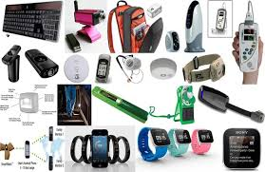
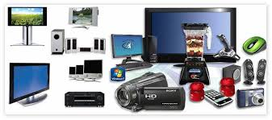
Consumer Electronics: Concorde Group have been in the electronics business several years ago and holds the exclusive distribution of more than 90 high end and premium brands in the Middle East and Africa Region. The group has local and regional expertise to deliver an unparalleled level of service, support, logistics and competitive pricing to the marketplace. The Group services all business sectors including wholesalers, small and medium retailers, value-added resellers, power retailers and corporate resellers. Our rapid expansion and commitment to service excellence has positioned the group as a leader in the region and a favorite source of products.

Slide 8
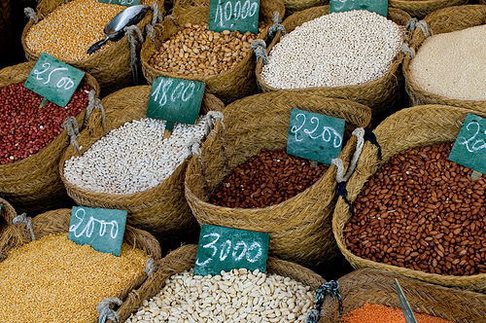
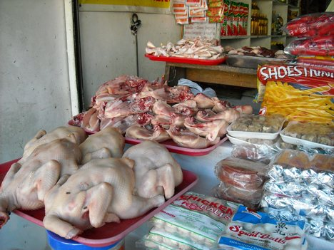
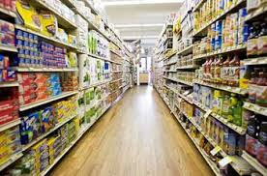

General Trading: in the enormous world of trading, Concorde Group stands to be a main provider of diversified goods and services in the African Region. Concorde Group owns an operates several companies in the democratic republic of Congo and Ivory Coast as well as African regions which are responsible for all commercial activities in the trading of FMCGs, Commodities and similar goods…. Concorde Group has more than 15 retail stores with massive warehouses strategically located to supply its local as well as surrounding African markets.

Slide 9
Real Estate: Concorde Group holds a wide range of real estate in Africa, UAE and Lebanon. The range of the properties administered and leased in the UAE and Africa includes industrial lands, warehouses, showrooms, workshops, offices, villas and apartment buildings. Also, the Group operates several real estate projects in prime areas in the Lebanese market by renting megastores, entertainment centers, cinemas, fast food chains, commercial stores and others to major clients.

Slide 10
Telecommunication: Concorde Group is a leading provider of value added Domestic and International Long Distance Telecommunication Services. This Service allows residential users, business associates and agents global access to over 300 Countries through a reliable and high quality network.

